Slide 1

IST 719 Information Visualization
Summer 2020
Laura C. Larregui
Visme
Create stunning visuals

Slide 2

What is Visme?
Visme is a Web-based content creation tool that allows people to create and present compelling stories in the form of engaging presentations, infographics, documents, videos, graphics and everything in between.

Slide 3

Made by designers for non-designers
Notes:
Visme is characterized for being a drag-and-drop tool. Thus, creators don't need to have tech or design skills to create ... There is also no need to waste time looking for high quality photos. Visme has access over 1.5 million stock photos and thousand of vector icons like the ones used through out this presentation.

Slide 4








Used by Many

Slide 5

How Does It Work?

Slide 6


Visualize Anything
Share Online or Privately
Custom
Add Data
Create
Edit
Share
Template
Download for Offline Use

Slide 7
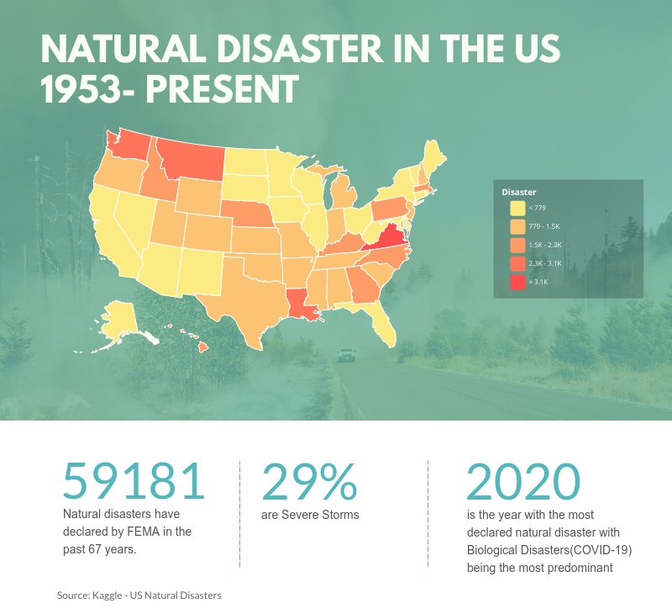

Slide 8

Benefits
Disadvantages
Everything in one place
Limitations with free package
Easy to use
Collaboration
Privacy control
Various mediums to download your content

Slide 9

Laura Larregui
lclarreg@syr.edu
To start creating your content go to www.visme.co
Questions
For tutorials go to
https://www.youtube.com/channel/UC2isRzoZisjBS6PaGWTDV0Q

